Slide 1
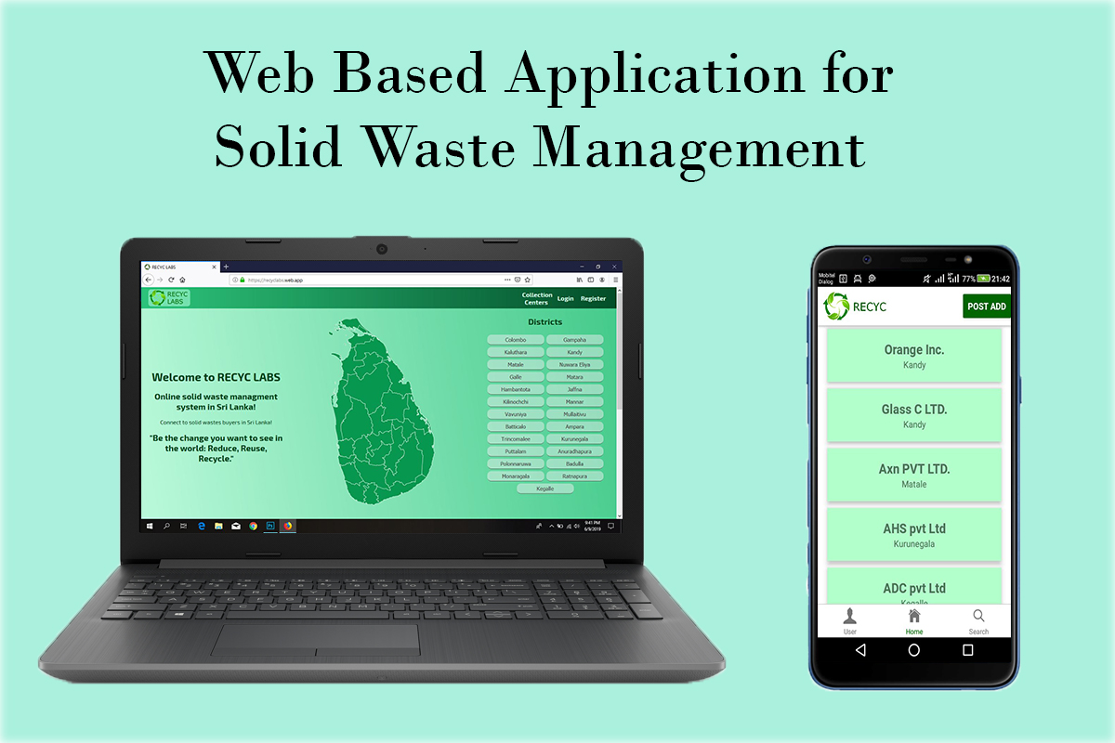

https://recyclabs.web.app

Slide 2
Group Members
M.M.M. ASLAM E/15/021
M.H. HISNI MOHAMED E/15/131
S. SUHAIL E/15/348
Product owner & Scrum Master: Miss. NIMALI KULARATNE
https://recyclabs.web.app

Slide 3
Introduction
A web based application for plastic & non-degradable waste management.
Helps public to interact with buyers.
Helps state health inspectors to track the waste disposal mechanism
https://recyclabs.web.app

Slide 4




Technologies Used
React JS, React Native
Firebase
https://recyclabs.web.app

Slide 5
Project Plan
Requirement gathering and getting familiar with
technologies
User interface designing
Database configuration
Implementing user registration & authentication
Cloud deployment & Configuration
Testing & Evaluation
https://recyclabs.web.app

Slide 6
Things Completed (Before Mid)
Gathered the requirement and got familiar with technologies
Designed the user interface
Configured the database
https://recyclabs.web.app

Slide 7
Things Completed (After Mid)
Implemented the user registration & authentication
Cloud deployment and configuration
Styling and UX improvement
https://recyclabs.web.app

Slide 8

Extra Milestones
Developing a Mobile App (Android)
Monitoring System/Portal for state health inspectors
https://recyclabs.web.app

Slide 9
Demo
https://recyclabs.web.app

Slide 10
Q & A
https://recyclabs.web.app

Slide 11
Thank You…

